Slide 1


Predictive Analysis on Airline Passenger Satisfaction with Classification Methods
UIC Team
TAN JING
WEI DONGLIN
YANG ZIJING
CHEN XIAOFENG

Slide 2
CONTENTS
Data pre-processing
Background & Purpose
02
01
05
Limitation & Conclusion
03
04
Data Description
Data processing

Slide 3

01
Background & Purpose

Slide 4



Background
Demand for high quality services of air travel has increased.
Airlines should focus on improving the quality of services.
Good services can help airlines win customer’s heart and stand out in the market.

Slide 5
Background
Customer satisfaction plays a crucial role in consuming behavior and the brand image of airlines
Maintaining customer satisfaction at a good level can help the airline occupy the aviation market and get plenty of repeat customers.

Slide 6
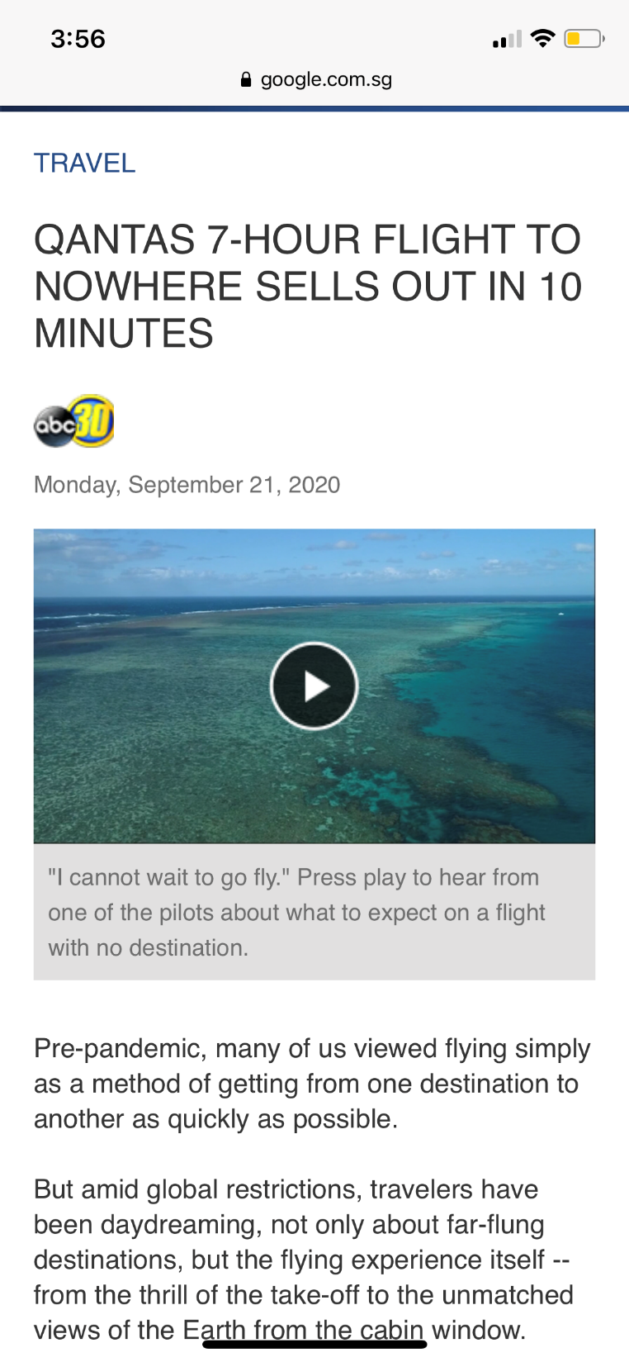
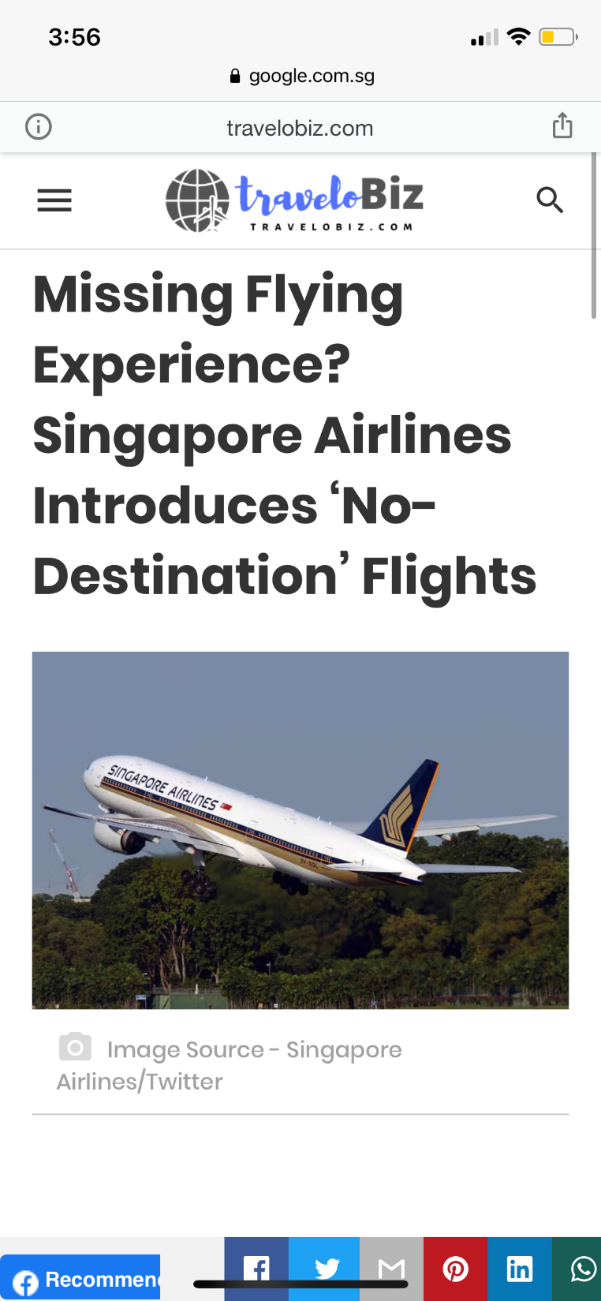

Background
Nowadays, the aviation industry was hit hard by the Covid-19.
In order to profit and reduce the loss, some airlines introduce “flights to nowhere”
People can enjoy the beautiful views and good services during the flight.

Slide 7
Purpose of Research
The purpose of this research is to find out
what factors lead to customer satisfaction for an Airline.

Slide 8
02
Data pre-processing

Slide 9

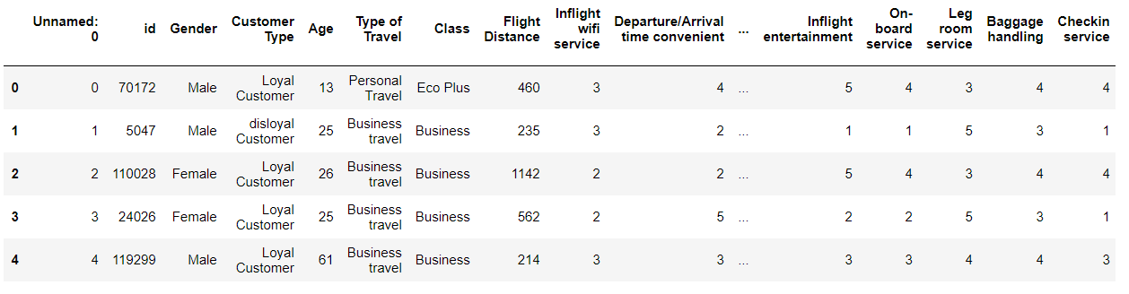
Data collection
https://www.kaggle.com/teejmahal20/airline-passenger-satisfaction
Kaggle Website
Dataset
training data: 103,904 records
testing data: 25,976 records

Slide 10
Data cleaning
Categorical value
Process
Gender Type
1: Female 0: Male
Customer Type
1: Loyal customer 0: Disloyal customer
Travel Type
1: Business Travel 0: Personal Travel
Seat Class Type
2: Business Class 1: Economic Plus Class
0: Economic Class
Satisfaction Attitude Type
1: Satisfied Attitude
0: Neutral or Dissatisfied Attitude
Drop outliers
Drop missing value
Transfer all the categorical values into numerical value

Slide 11
03
Data Description

Slide 12




Data Description
General Trend of Dataset
Description of Target Feature
Count Plot Description
Numerical and
Categorical Features
Correlation

Slide 13
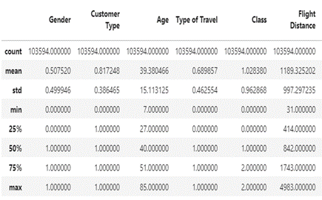
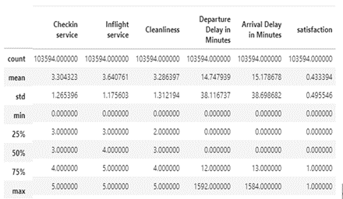
Numerical and Categorical Features
Categorical Features
Numerical Features

Slide 14
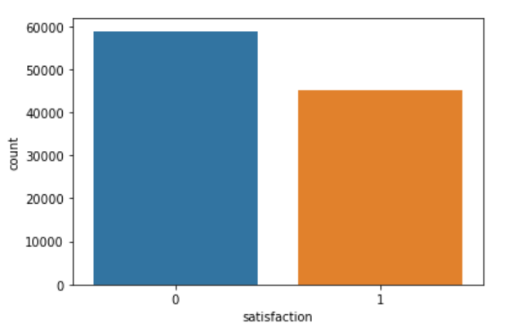
Description of Target Feature
1：Satisfied attitude
0：Dissatisfied attitude
30% More
Fig. Satisfaction Level Description

Slide 15
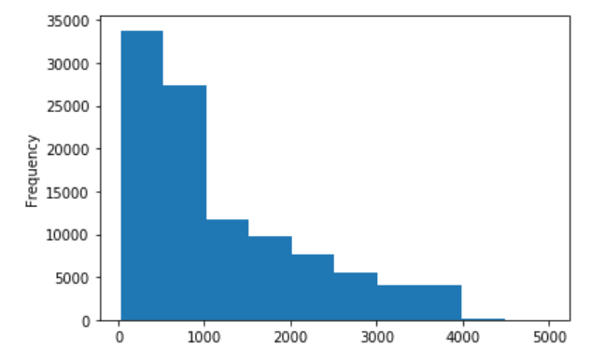
General Trend of Dataset
Fig. Flight Distance Frequency Distribution

Slide 16
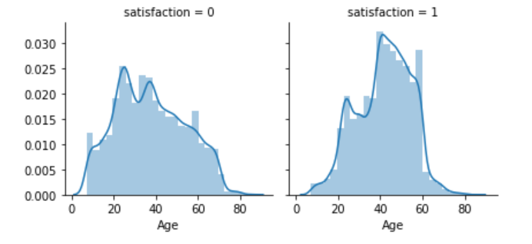
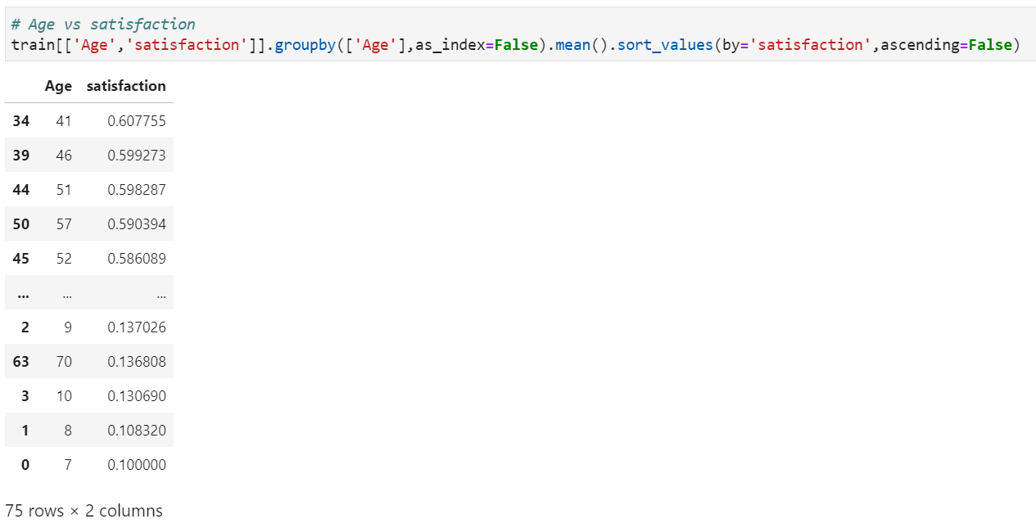
General Trend of Dataset
Fig. Age & Satisfaction Relation Tendency
Fig. Age & Satisfaction Correlation Graph

Slide 17
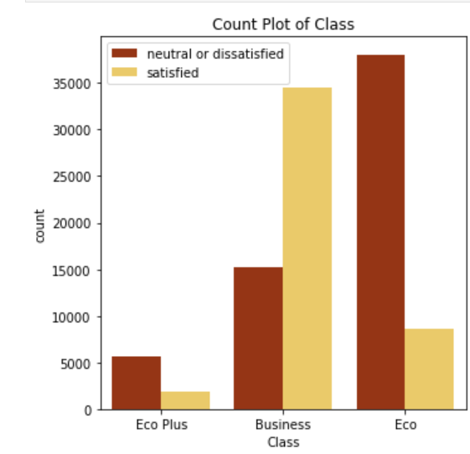
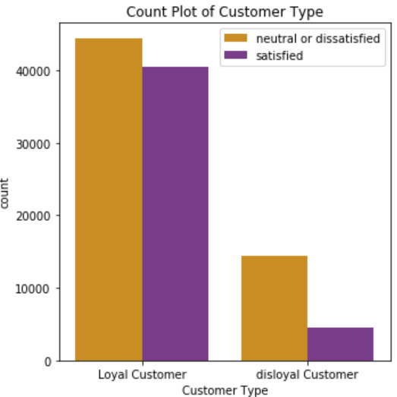
Count Plot Description
Fig. Count Plot of Flight Seat Class
Fig. Count Plot of Customer Type

Slide 18
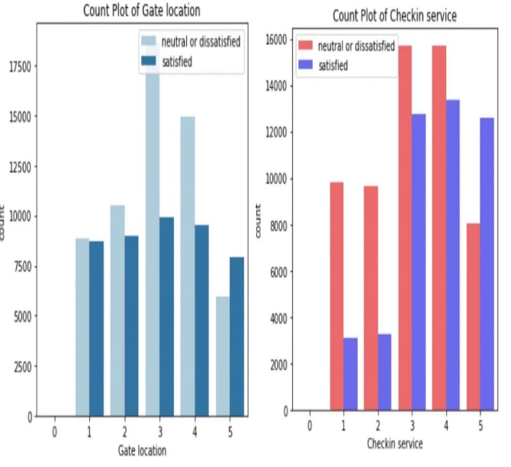
Count Plot Description
Fig. Count Plot of Gate location & Check in service

Slide 19
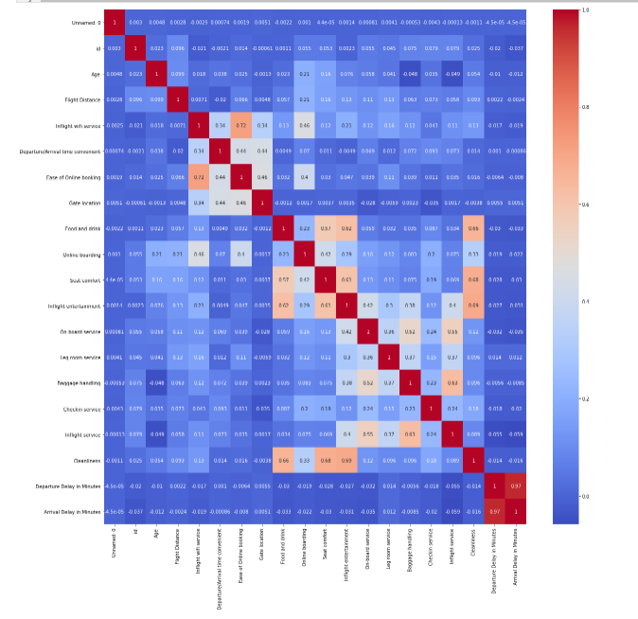
Correlation
Fig. General Correlation Table

Slide 20
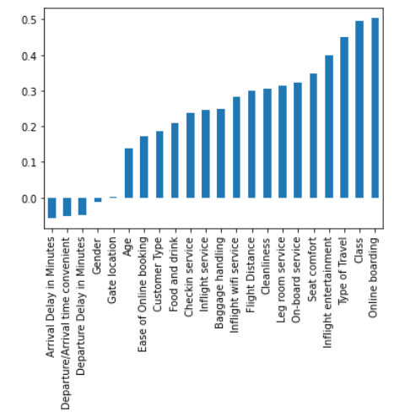
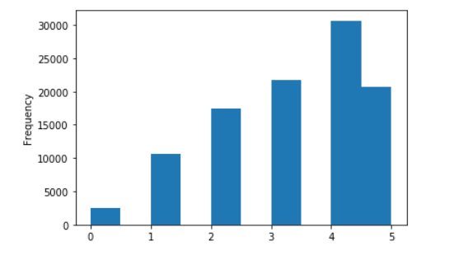
Correlation
Fig. The Correlation Table between Satisfied Level & Other Features
Fig. The Correlation Table between Online Boarding & Other Variables

Slide 21
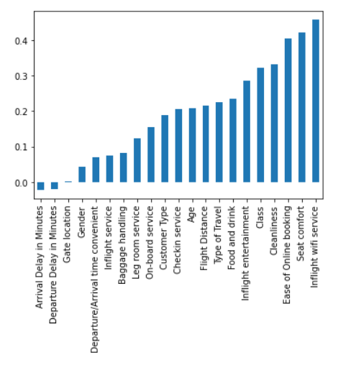
Correlation
Fig. The Correlation Table between Food and Drink service & Passenger Satisfaction

Slide 22
04
Data processing

Slide 23
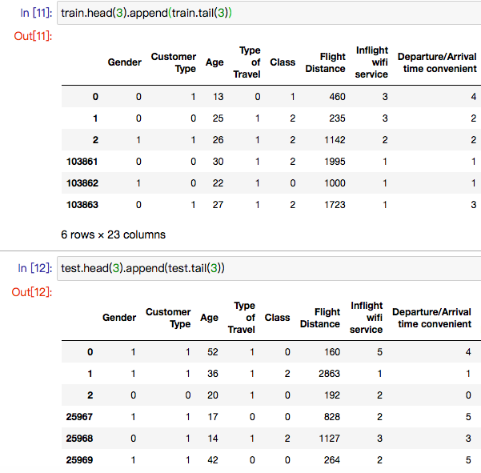

Train/Test Split
103864
25%
Training
25970
Testing

Slide 24
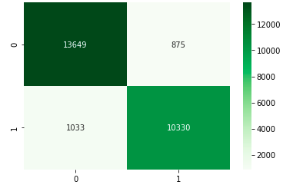
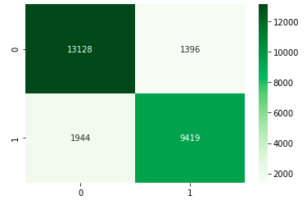
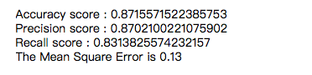
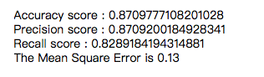
Model Evaluation
Confusion Matrix for Logistic Regression
Confusion Matrix for Linear SVM
Evaluation Score for Logistic Regression
Evaluation Score for Linear SVM

Slide 25
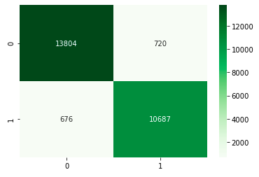
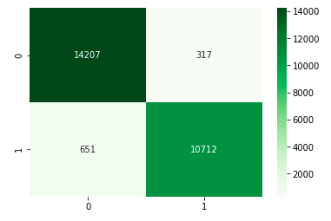
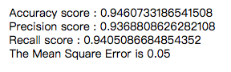
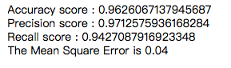
Model Evaluation
Confusion Matrix for Decision Tree
Confusion Matrix for Random Forest
Evaluation Score for Decision Tree
Evaluation Score for Random Forest

Slide 26


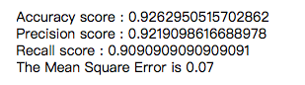
Model Evaluation
Confusion Matrix for Ada-Boost
Evaluation Score for Ada-Boost

Slide 27
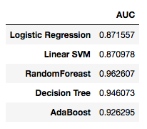
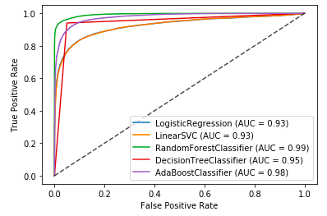
Comparison & Model Choosing
 | CPU times | Wall time
Logistic Regression | 482ms | 275ms
Linear SVM | 31.8s | 31.8s
Decision Tree | 732ms | 733ms
Random Forest | 14.2s | 14.4s
Ada-Boost | 5.63s | 5.79s
ROC-Curve for five classifiers
Accuracy for five classifiers
Running time for five classifier

Slide 28
05
Limitation & Conclusion

Slide 29
Limitation
Limitation
There are too many variables so that some classifier models such as logistic model and decision trees, cannot visualize the relationships of variables.

Slide 30
Conclusion
Online boarding service, seat class, and type of travel have a strong positive correlation with customers’ satisfaction attitude
Airlines can improve customers’ satisfaction by improving online boarding service.
Airlines should try their best to reduce the situation of arrival and departure delay caused by human factors.
Gender, departure or arrival time convenience, and arrival and departure delay have a negative correlation with customers’ satisfaction attitude
Random forest is the appropriate classifier to analyze flight passengers’ satisfaction.

Slide 31
Reference
Asyiqin, S., 2020. Singapore Airlines Introduces No-Destination Flights For Those Who Miss Flying. [online] WORLD OF BUZZ. Available at: <https://worldofbuzz.com/singapore-airlines-introduces-no-destination-flights-for-those-who-miss-flying/> [Accessed 12 November 2020].
Qantas 7-hour flight to nowhere sells out in 10 minutes. (2020). Retrieved 12 November 2020, from https://abc30.com/flight-to-nowhere-qantas-airlines-flights-with-no-destination-flying-in-covid-19-pandemic/6454022/

Slide 32
THANK YOU

